Slide 1

Development of ESG Investing:
Selection and Management of Investments
Brief Summary of ESG & Faith-Based Investing
DR. IRENE KIM, CPA
ASSOCIATE DEAN OF STUDENTS & FINANCE DIRECTOR
BUSCH SCHOOL OF BUSINESS

Slide 2
ESG Growth Forecast

Slide 3
Issues with ESG Investing
L-T risk vs short-term portfolio returns
Classification by regulators and investors
Current events and the response in an investor’s portfolio
Response from companies

Slide 4
Catholic-Based Investing
U.S. Conference of Catholic Bishops (USCCB) Investment Guidelines
2003 guidelines updated in 2021
  Primary Changes
  Busch School USCCB Investing Symposium
3 Investing Strategies
I. Avoid Doing Harm
II. Actively Work for Change
III. Promote the Common Good

Slide 5
USCCB Guidelines
Specific Investment Policies
Investment Policy | Examples
I. Promoting Human Life | Abortion, Euthanasia, Genetic modification
II. Promoting Human Dignity | Human Rights, Labor Rights, Contraceptives
III. Enhancing the Common Good | Arms Production, Gambling, Tobacco
IV. Pursuing Economic Justice | Social, environmental, financial performance
V. Saving our Global Home | Climate change, water and natural resources

Slide 6
CUA Catholic
Conscience Investing
CUA’s Investment Policy: use investment strategies that are aligned with the USCCB Guidelines and Catholic teaching

Slide 7
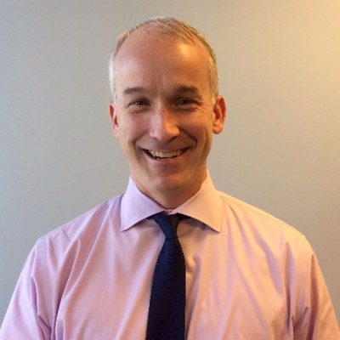
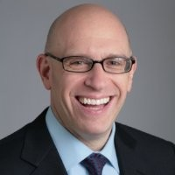
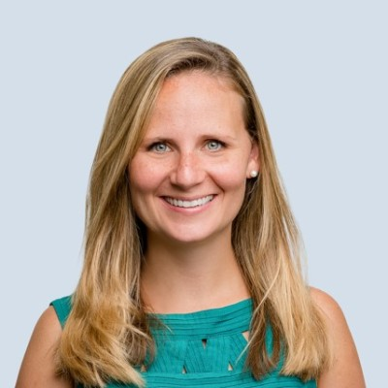
Panelists
Eric Meyers, CFA
Congress Asset Mgmt
Vice President
Portfolio Manager
Bruce H. Goldfarb
Okapi Partners
President & CEO
Heather Matranga
Village Capital
VP of Impact Investments and Innovation

